Slide 1
COURSERA CAPSTONE
IBM DATA SCIENCE
FINDING THE LOCATIONS OF PHARMACIES, GROCERY
STORES AND DEPARTMENT STORES IN TORONTO
DURING COVID-19 LOCK DOWN.
SAI KRISHNA ADUSUMILLI

Slide 2
INTRODUCTION
The lock down due to COVID-19 has really became a primary problem for people. People are finding difficulties for grocery stores and pharmacy stores which are in-active.
This project fetches the list of grocery stores and pharmacy stores in Toronto Area. Therefore it might be helpful for an individual who is in need of groceries and medicines. With the purpose in mind, this project is designed to find all the locations of grocery stores and pharmacy stores in and neighbourhood of Toronto.

Slide 3
BUSINESS PROBLEM
During the lock down, the need of groceries and medicines has become primary concern for people.
The main objective is to find ideal locations in the city for the people looking forgrocery stores and pharmacy stores.
TARGET AUDIENCE OF THIS PROJECT
This project is particularly useful for the people living in Toronto, who are
seeking to find pharmacies, grocery stores and department stores during this
COVID-19 lock down.

Slide 4
DATA
The data needed for this project :
List of neighborhoods in Toronto, Canada.
Latitude and Longitude of these neighborhoods. (It is provided in COURSERA Data Science Capstone Project week 3 as .csv file)
Venue data related to Groceries and pharmacy stores.
Sources of data :
Scrapping of Toronto neighborhoods via Wikipedia. (https://en.wikipedia.org/wiki/List_of_postal_codes_of_Canada:_M)
Getting Latitude and Longitude data of these neighborhoods. (http://cocl.us/Geospatial_data)
Using Foursquare API to get venue data related to these neighborhoods.

Slide 5
Description and extraction of data :
Fetching the data from the web page (https://en.wikipedia.org/wiki/List_of_postal_codes_of_Canada:_M) which contains a list of postal codes in Canada where the first letter is M. Postal codes beginning with M are located within the city of Toronto in the province of Ontario.
Using beautifulsoup package, the data from above web page is scrapped and converted into a pandas data frame.
Data cleaning for the obtained data frame is done by removing the rows those contain Borough value as ‘Not Assigned’ and then concatenating the data which contains same value of Postal Code & Borough.
Data from (http://cocl.us/Geospatial_data) contains latitude and longitude of places based on the Postal Codes. This link returns a .csv file.
The data is downloaded from the above web page and the .csv file data is converted into data frame using pandas.
Now, the two data frames are merged based on Postal Codes.
Venue data of a place is collected using foursquare.

Slide 6
METHODOLOGY
Python Data Science tools are used to analyze data. Complete code can be
found here - https://github.com/Krish716/CourseraIBM_Capstone/blob/master/CapstoneFinal.ipynb
First insight using visualization:
Map of Toronto and its neighbourhood is visualized using the data frame which contains list of places in and around Toronto, Canada. The figure.1 shows the map illustrates the above point.

Slide 7
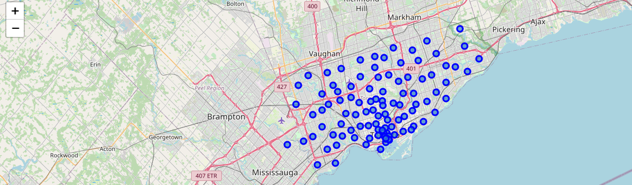
figure. 1

Slide 8
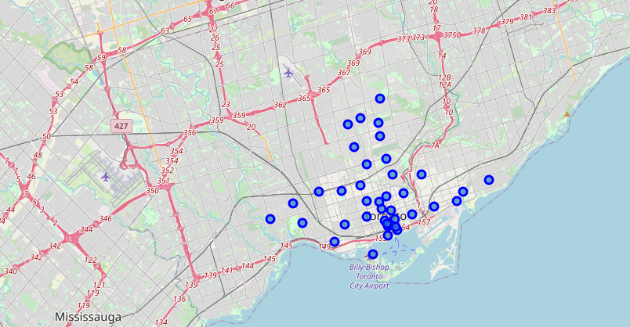
Now fetching the data which contains Toronto in Borough column and visualizing those places. This is shown in figure.2 .
figure. 2

Slide 9
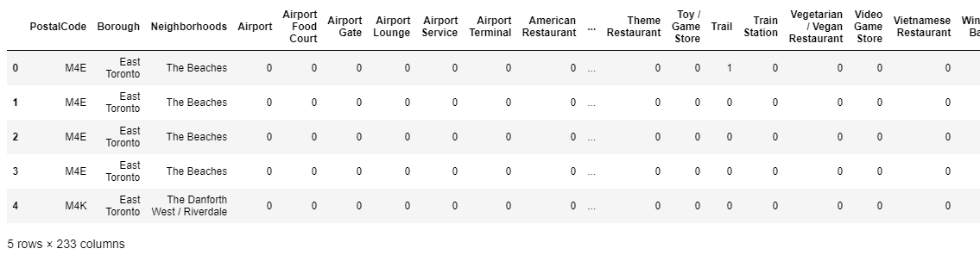
Using foursquare, the venue data for the places is collected by the url- “https://api.foursquare.com/v2/venues/explore?client_id={}&client_secret={}&v={}&ll={},{}&radius={}&limit={}” .
Now one hot encoding is performed to analyze neighbourhood using postal codes and venue data.The following table.1 shows the table after one hot encoding.
table. 1

Slide 10
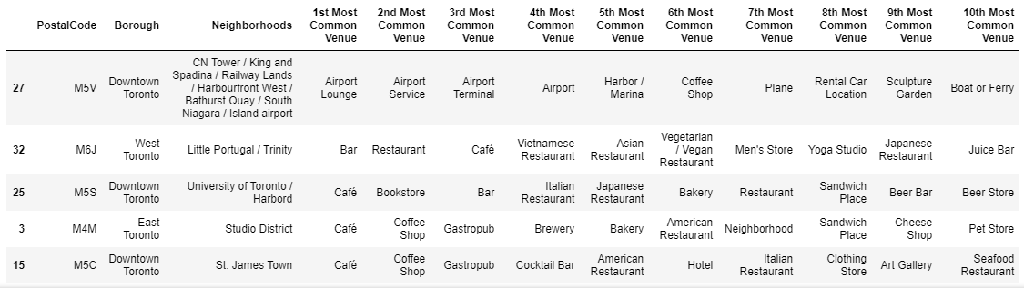
Then, we fetch top 10 venues for each area noted in the data frame. The data frame looks like below table.2.
table. 2
Then clustering is performed on the data frame to cluster the areas located in the Toronto.

Slide 11
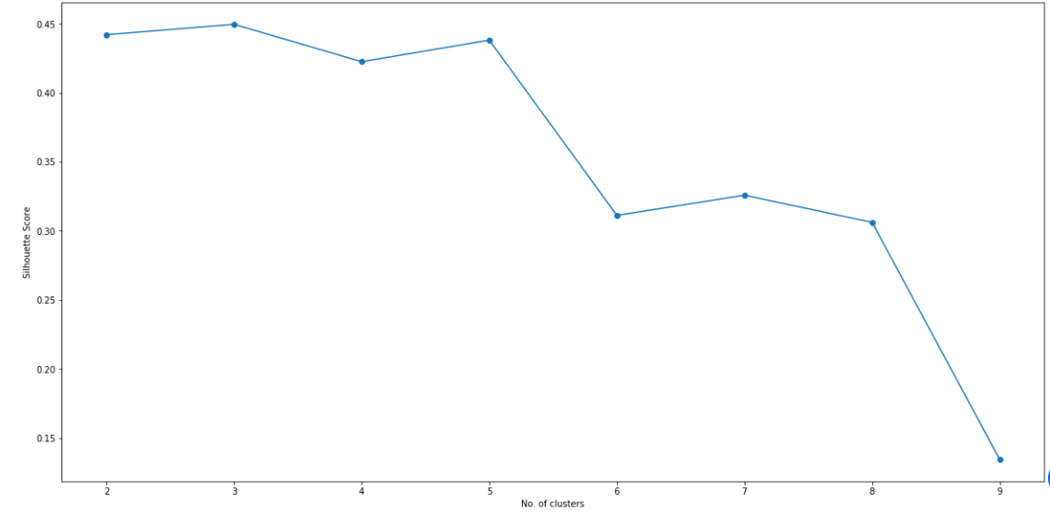
On the basis of Silhouette scores, the optimum value of k in K-means Clustering is obtained. The plot between number of clusters and Silhouette scores is shown in figure.3 .
figure. 3

Slide 12
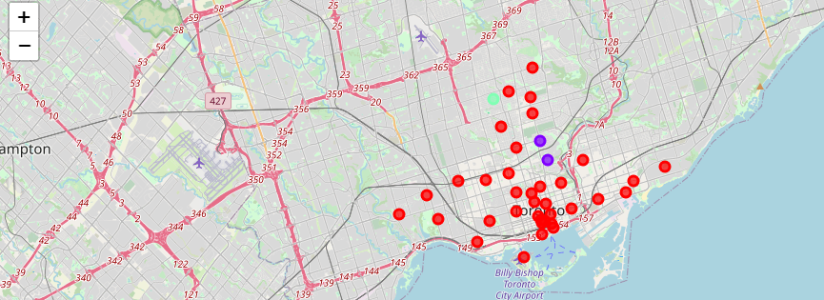
After getting the k value, respective clusters will be assigned to the areas in the data frame. The clusters obtained is shown in figure.4 .
figure. 4
Now the above steps are performed to identify Pharmacies, grocery stores and department stores in respective clusters.

Slide 13
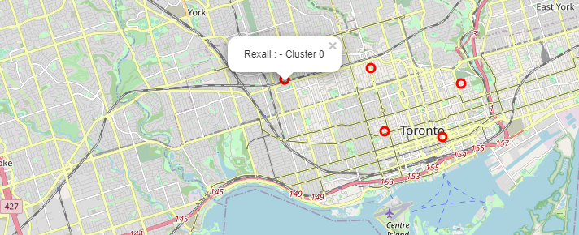
RESULTS
After obtaining the data frames for each venue category - Pharmacy, Grocery Store and Department Store. The resulting maps by clusters for Pharmacy, Grocery Store and Department Store is shown in figure.5,
figure.6 and figure.7 respectively.
figure. 5

Slide 14
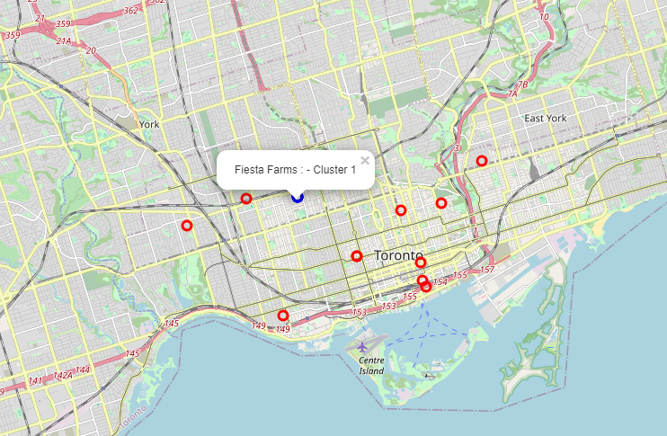
figure. 6

Slide 15
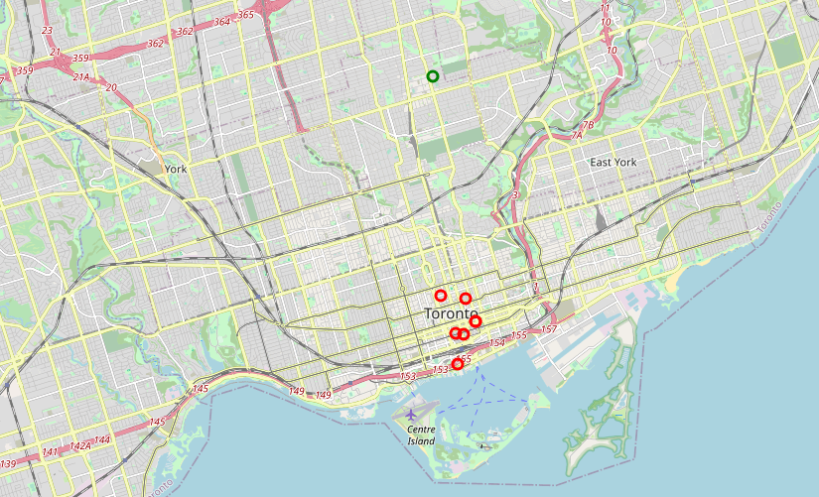
figure. 7

Slide 16
CONCLUSION
Pharmacy- There are 7 pharmacies located in cluster 0 where in cluster 1 & cluster 2, there are no pharmacies.
Grocery Store- There are 11 grocery stores located in cluster 0 and 4 in cluster 1. In cluster 2, there are no grocery stores.
Department Store- There are 7 department stores located in cluster 0 and 1 in cluster 0. In cluster 1, there are no department stores.
For more cluster analysis and result set, visit-
https://github.com/Krish716/CourseraIBM_Capstone/blob/master/CapstoneFinal.ipynb
This provide provides all the locations of Pharmacies, Grocery Stores and Department Stores in Toronto based on the data set obtained.

